Slide 1
Molecular Biology Biol 480
Lecture 17 February 27th, 2019

Slide 2
Announcements/Assignments
Lab depends on arrival of primers. Shipment not here! Will it arrive for 10 am lab?...
Keep reviewing lectures every day. Use the lecture summary tool, if it works for you.
Exam 2 March 4th.
No lecture March 8th. This is the ND Academy of Science meeting in Grand Forks.

Slide 3
Where were we?
TRANSCRIPTION—starting with prokaryotes
Sketch a gene—along a single line
Sketch a gene showing 2 strands---label the strands
Show the details of a promoter region
Cis and Trans elements of transcription
Initiation, elongation, termination

Slide 4
good animations…
http://www.dnalc.org/resources/3d/12-transcription-basic.html
http://www.hhmi.org/biointeractive/dna-transcription-advanced-detail#video-7b9676a4-5f24-4837-9aaf-9352eed43c1e

Slide 5
Transcription termination
In E. coli, RNA polymerase rides along the DNA, producing RNA until it encounters a nucleotide sequence called a terminator sequence.

Slide 6
“Consensus” sequence of terminator
Prokaryotic terminator sequences typically have a G-C rich 5’ region and a 3’ end that includes in a string of A nucleotides.
The terminator DNA sequence is about 40 nucleotides long and RNA polymerase transcribes the sequence into RNA.

Slide 7
DNA and RNA play a role in termination…
Near the end of the terminator, the RNA is complementary to a downstream region, and like many RNA sequences, can form intrastrand complementary base pairs.

Slide 8
Intrastrand base-pairing forms secondary structure in the RNA. The terminator forms a type of secondary structure sometimes called a hairpin, but which resembles this stem-loop.

Slide 10
How termination is thought to work…

Slide 11
Note---that the RNA itself assists in transcription termination. This is called intrinsic termination. No other factors are necessary.
Termination is especially important in prokaryotes because protein encoding genes are located so near each other!

Slide 12
Rho-dependent termination
Some E. coli genes cannot terminate with the terminator sequence alone. They require an additional protein factor.
The factor is called Rho (ρ).
Rho is thought to dislodge both RNApol and the new RNA from the DNA template

Slide 14
Depending on the gene, many rounds of transcription will occur is succession so many molecules of RNA are formed from the same gene.
(See picture at beginning of chapter 13)

Slide 15
Electron microscope image Transcription trees

Slide 16
Transcription tree---be sure to understand what each part represents

Slide 17
Although the synthesis of RNA is basically the same in prokaryotes and eukaryotes…There are some significant differences/additions.

Slide 18
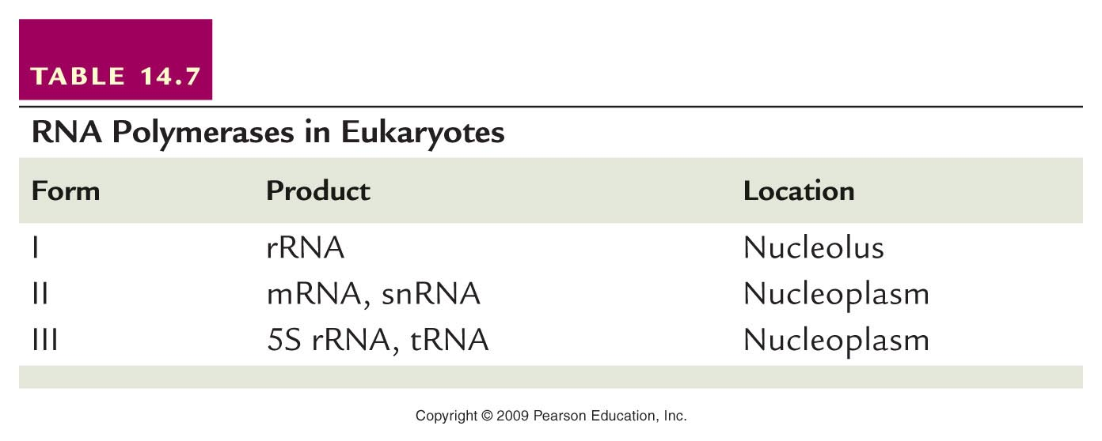
In Eukaryotes…
Transcription of different types of RNA is accomplished by 3 different RNA polymerases: I, II, III. Table _____
, miRNAs

Slide 19
Eukaryotic gene promoters
Focus on RNA polymerase II transcribed genes. (RNApol II transcribes pre-mRNA)
Transcription factors that assist RNAP II are known as TF II _____s.
Core promoter elements.
TATA box

Slide 20
The element of the promoter common to all RNAPII genes is called the core promoter. The core promoter nearly always contains an element known as the TATA box (or Goldberg-Hogness) box at about -30.
The consensus TATA box is TATA(A or T)AA(A or G)

Slide 21
The TATA box resembles the -10 consensus of the prokaryotic promoter, but does not bind RNAPII directly.
The core promoter binds a number of proteins known as transcription factors (TFs). Since any level of transcription using RNAPII requires these factors, they are called general or basal TFs.

Slide 22
TFIID consists of a bunch of individual proteins. Only a few of the proteins interact with DNA. The others bind each other, in a specific way, in a specific order.
TATA-binding protein-TBP
(Recall the blobs entering the picture in the transcription video)

Slide 23
Holo TFIID (This is just ONE eukaryotic transcription factor!)

Slide 24
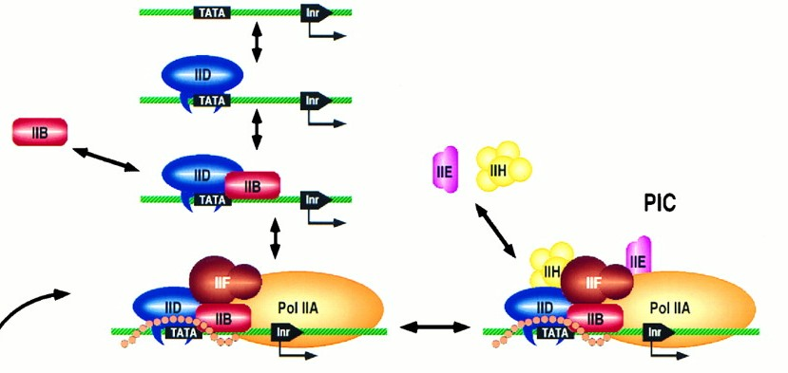
Other TFII factors bind sequentially to the assembled TFIID.

Slide 25
A second component of the core promoter is called the initiator element (INR), which is the actual DNA binding site for the RNAPII.
The INR consensus is PuPuCAPyPyPyPyPy, where Pu is either purine and Py is either pyrimidine.

Slide 27
On either side of the TATA box and INR can be additional elements in the core promoter.
Upstream core elements are called proximal promoter elements.
While these can vary more than the TATA box consensus there are a small number of distinct sequences that are used in eukaryotic promoters.

Slide 28
Some common ones…

Slide 29
One example…
CAT box

Slide 30
Downstream from the TATA box can be found an additional core promoter element called the distal promoter element or DPE
The DPE seems to be essential in some eukaryotic genes for binding specific TFII basal transcription factors. It is not present in promoters of all eukaryotic genes.

Slide 33
Distant regulation
Finally, transcription initiation may require additional, cell-specific TFs that bind sequences outside the promoter.
A common cis element that boosts the rate of transcription initiation significantly is called an enhancer.

Slide 35
The current idea on how enhancers enhance transcription is that the sequences attract and bind activator proteins.
Through a looping out of DNA between the enhancer and promoter, the activator protein(s) does make contact with the basal TFs, which somehow starts the RNAP II transcribing the gene.

Slide 36
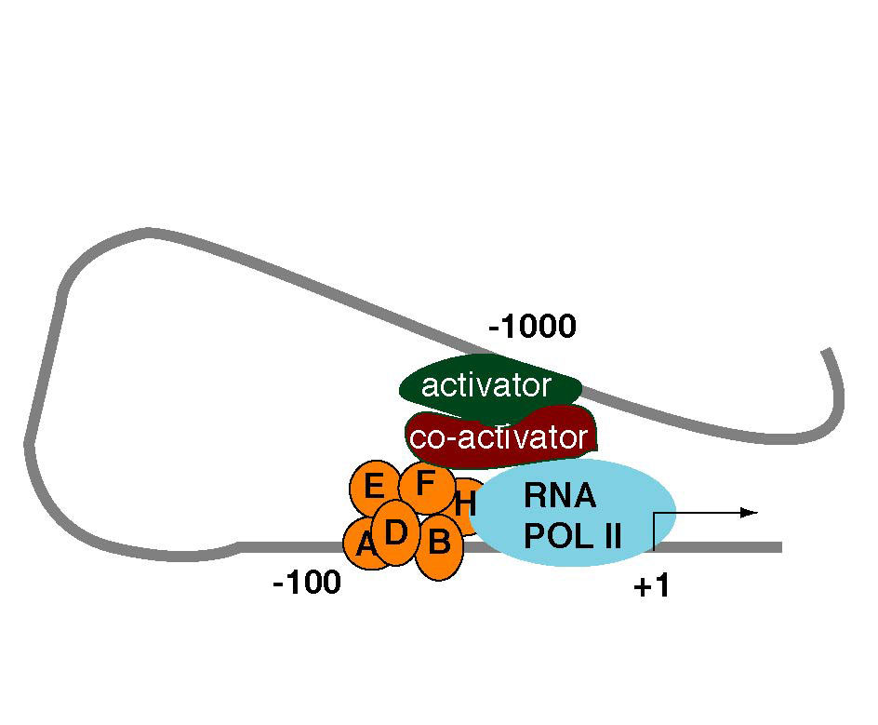
Enhancers can be located thousands of bp away from the promoter and start site of transcription.

Slide 37
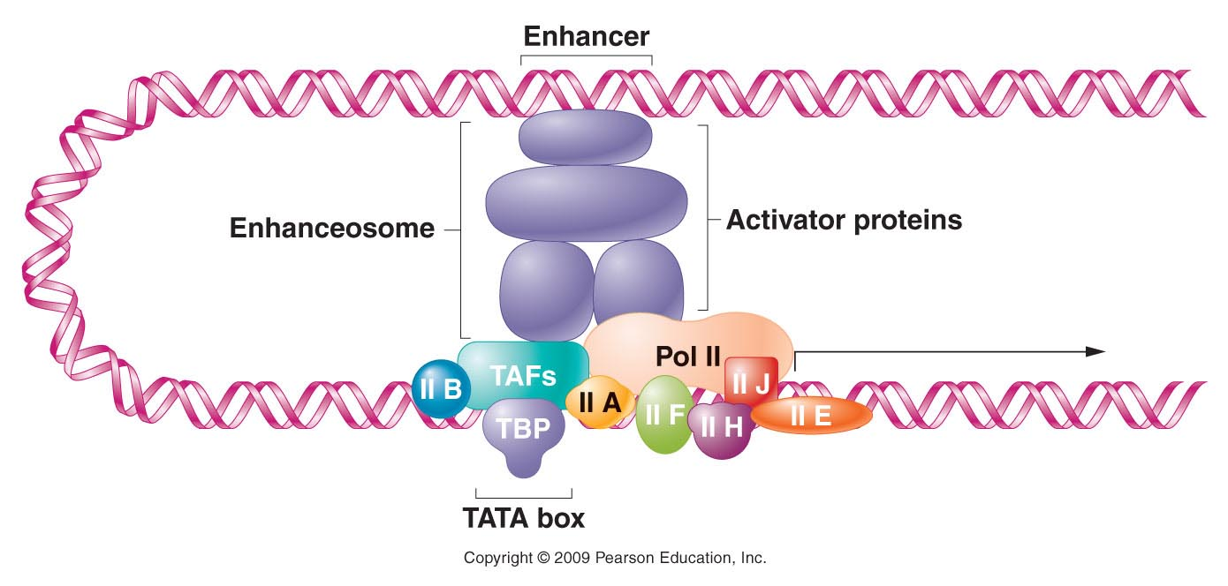
Figure 18.15
Notes:
Figure 18-15 Formation of DNA loops allows factors that bind to enhancers at a distance from the promoter to interact with regulatory proteins in the transcription complex and to maximize transcription.

Slide 38
We’ve learned that transcription initiation is a pretty complicated matter. A lot of proteins (trans elements) must meet up at the right place (the cis elements of the gene) and at the same time.
Why would such a complex system be used?
After all, our cells must have a constant supply of RNAs and proteins to carry out all the activities they use to function as cells.

Slide 39
1. Energy conservation
Transcription and translation require a constant supply of building blocks and energy. Cells can’t be wasteful, making macromolecules that aren’t needed all the time.
2. Specialization
Cells make a specific subset of RNAs and proteins that allow them to do specific activities. Transcription initiation regulation is the primary mechanism for controlling gene expression.

Slide 40
Specialization is, in large part, controlled with those elements that act at a distance—the enhancers and the activator proteins that bind them.
We will return to this soon!

